Slide 1


Sreeharsha Sadhu
12/02/2025

Slide 2

Outline
Executive Summary
Introduction
Methodology
Results
Conclusion
Appendix

Slide 3
Executive Summary
Summary of methodologies
Data Collection
Data Wrangling
EDA with Data Visualization
EDA with SQL
Building an Interactive Map using Folium
Building a Dashboard using Plotly DASH
Predictive Analysis - Classification
Summary of all results
EDA Results
Interactive Environment Sreenshots
Classification Model Results

Slide 4
Introduction
Project background and context
SpaceX is the most successful company of the commercial space age, making space travel affordable. The company advertises Falcon 9 rocket launches on its website, with a cost of 62 million dollars; other providers cost upward of 165 million dollars each, much of the savings is because SpaceX can reuse the irst stage. Therefore, if we can determine if the first stage will land, we can determine the cost of a launch. Based on public information and machine learning models, we are going to predict if SpaceX will reuse the first stage.
Problems you want to find answers
How is the success of the first stage landing affected by various factors such as payload mass, launch site, no. of flights, orbits, etc?
How has success rate varied over time?

Slide 5

Section 1

Slide 6
Methodology
Executive Summary
Data collection methodology:
Using SpaceX REST API
Web Scrapping from Wikipedia
Perform data wrangling
Data Filtering
Handling Missing Values
Using Encoding to restructure data for classification
Perform exploratory data analysis (EDA) using visualization and SQL
Perform interactive visual analytics using Folium and Plotly Dash
Perform predictive analysis using classification models

Slide 7
Data Collection
The data collection process involved utilizing a combination of two methods: API requests from the SpaceX REST API and web scraping data from a table in SpaceX’s Wikipedia entry. These methods were employed together to ensure the collection of complete information on the launches, enabling a more detailed analysis.
From the SpaceX REST API, the following data columns were retrieved: Flight Number, Date, Booster Version, Payload Mass, Orbit, Launch Site, Outcome, Flights, Grid Fins, Reused, Legs, Landing Pad, Block, Reused Count, Serial, Longitude, and Latitude. These columns provided detailed technical data about each launch, including information about the rocket components, landing details, and geographical information.
In addition, data was obtained through web scraping from SpaceX’s Wikipedia page. The columns collected via this method included Flight Number, Launch Site, Payload, Payload Mass, Orbit, Customer, Launch Outcome, Booster Version, Booster Landing, Date, and Time. This data complemented the information from the API, offering insights such as customer details and the specific timing of the launches.
By combining data from both the SpaceX REST API and the Wikipedia web scraping, a comprehensive dataset was created for a more thorough analysis of SpaceX's launch history.

Slide 8
Data Collection – SpaceX API
Make a GET request to SpaceX API to obtain launch data
Convert HTTP Response to a DataFrame using the JSON library
Filter to keep only the required attributes in the data
Make specialized API calls to extract additional data from the API
Construct a Dataset using the data extracted from the responses
Filter to only include data for Falcon 9 data
Handle missing values through mean imputation
Github: Data Collection using SpaceX API

Slide 9
Data Collection - Scraping
Make a GET request to Wikipedia to obtain HTML content
Create a BeautifulSoup object to parse the HTML content
Extract table headers from BeautifulSoup object
Extract table rows into a dictionary with Table headers as keys
Construct a dataframe using the table dictionary
Export the dataframe as a CSV
Github: Data Collection using Webscrapping

Slide 10
Data Wrangling
Load the dataset and required processing libraries
Determine the percentage of missing values for each attribute
Calculate the number of launches from different launch sites
Calculate the number of launches onto different orbits
Calculate the outcomes for each mission
Create a new attribute for landing outcome and append to dataframe
Determine Success Rate of all landings based on the new attribute
Export the dataset to a CSV
Github: Data Wrangling

Slide 11
EDA with Data Visualization
Scatter Plots:
Importance: Scatter plots are used to observe relationships between two continuous variables. They help in identifying patterns, trends, and potential correlations.
Graphs:
FlightNumber vs. PayloadMass with Class as hue.
FlightNumber vs. LaunchSite with Class as hue.
PayloadMass vs. LaunchSite with Class as hue.
FlightNumber vs. Orbit with Class as hue.
PayloadMass vs. Orbit with Class as hue.
Github: EDA with Data Visualization

Slide 12
EDA with Data Visualization
2. Bar Charts:
Importance: Bar charts are used to compare categorical data. They are useful for showing the distribution of data across different categories.
Graphs:
Success rate of each orbit type.
3. Line Charts:
Importance: Line charts are used to display trends over time. They are useful for showing how a variable changes at regular intervals.
Graphs:
Yearly trend of launch success rates.
Github: EDA with Data Visualization

Slide 13
EDA with SQL
SQL Queries Performed:
Display the names of the unique launch sites in the space mission
Display 5 records where launch sites begin with the string 'CCA’
Display the total payload mass carried by boosters launched by NASA (CRS)
Display average payload mass carried by booster version F9 v1.1
Display the date when the first successful landing outcome in ground pad was achieved
List the names of the boosters which have success in drone ship and have payload mass greater than 4000 but less than 6000
List the total number of successful and failure mission outcomes
List the names of the booster versions which have carried the maximum payload mass
List the failed landing outcomes in drone ship, their booster versions, and launch site names for the year 2015
Rank the count of landing outcomes between the date 2010-06-04 and 2017-03-20, in descending order
Github: EDA with SQL

Slide 14
Build an Interactive Map with Folium
1. Markers:
Launch Sites: Added markers for each launch site to indicate their locations on the map.
Launch Outcomes: Added markers for each launch with different colors (green for success and red for failure) to indicate the outcome of each launch.
2. Circles:
Launch Sites: Added Circles around each launch site to highlight their locations.
3. Lines:
Proximity Lines: Added lines between launch sites and their proximities (e.g., railway, highway, coastline, city) to visualize the distances.
Github: Interactive Map with Folium

Slide 15
Build a Dashboard with Plotly Dash
1. Dropdown List: Launch Site Selection: A dropdown list that allows users to select a specific launch site or view data for all sites. This interaction helps users filter the data based on the launch site of interest.
2. Pie Chart: Success Counts: A pie chart that displays the total successful launches count for all sites or the success vs. failed counts for a selected site. This plot provides a visual summary of launch outcomes, making it easy to compare the success rates across different sites.
3. Range Slider: Payload Range Selection: A range slider that allows users to select a range of payload masses. This interaction helps users filter the data based on payload mass, enabling analysis of how payload mass affects launch success.
4.Scatter Chart: Payload vs. Success Correlation: A scatter chart that shows the correlation between payload mass and launch success. This plot helps users visualize the relationship between payload mass and the likelihood of a successful launch, providing insights into the impact of payload mass on launch outcomes.
Github: Plotly Dash App

Slide 16
Predictive Analysis (Classification)
Data Pre-Processing
Model Development
Model Evaluation
Model Comparison
Data Pre-Processing:
Load Data: Imported the dataset
Handle Missing Values: Imputed null values with mean of the attribute.
Standardize Data: Used StandardScaler to standardize the features.
Data Split: Split the total data into Train and Test sets for model training and testing
Model Building:
Model Selection: Trained different ML models that include Logistic Regression, Support Vector Machine, Decision Tree, and k-Nearest Neighbors
Hyperparameter Tuning: Utilizied GridSearchCV to find the best hyperparameters for each of the models used
Github: Predictive Analysis

Slide 17
Predictive Analysis (Classification)
Data Pre-Processing
Model Development
Model Evaluation
Model Comparison
Model Evaluation:
Accuracy: Evaluated the accuracy of each model on the test data.
Confusion Matrix: Plotted confusion matrices to visualize the performance of each model.
Jaccard Score and F1 Score: Calculated Jaccard and F1 scores for each model.
Model Comparison:
Compare Scores: Compared the accuracy, Jaccard score, and F1 score of all models.
Best Model Selection: Selected the model with the highest scores as the best performing model.
Github: Predictive Analysis

Slide 18
Results
Exploratory data analysis results
Interactive analytics demo in screenshots
Predictive analysis results

Slide 19

Section 2

Slide 20
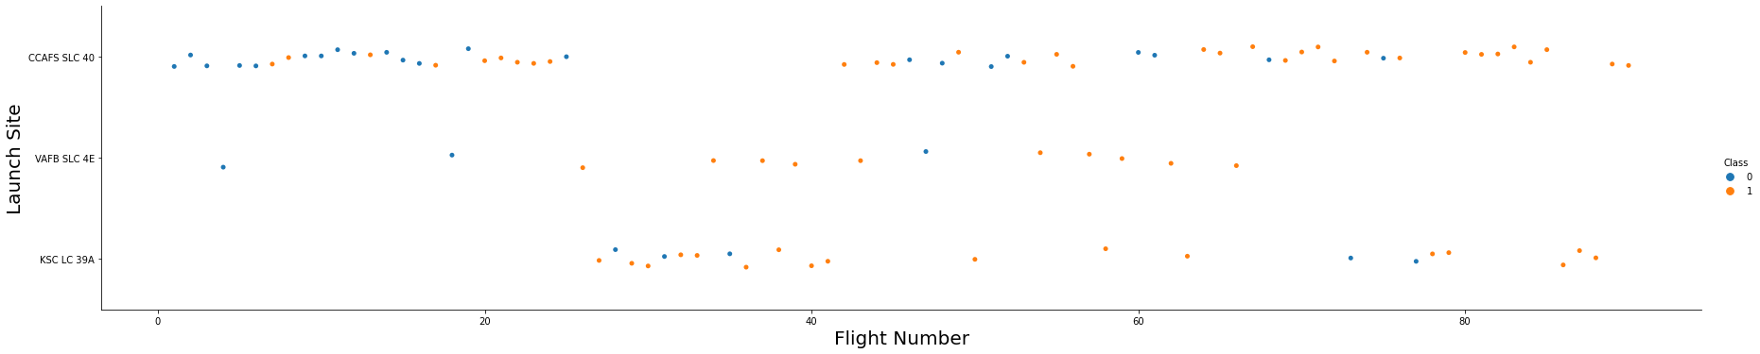
Flight Number vs. Launch Site
Explanation:
- The earliest flights all failed while the latest flights all succeeded.
- The CCAFS SLC 40 launch site has about a half of all launches.
- VAFB SLC 4E and KSC LC 39A have higher success rates.
- It can be assumed that each new launch has a higher rate of success.

Slide 21
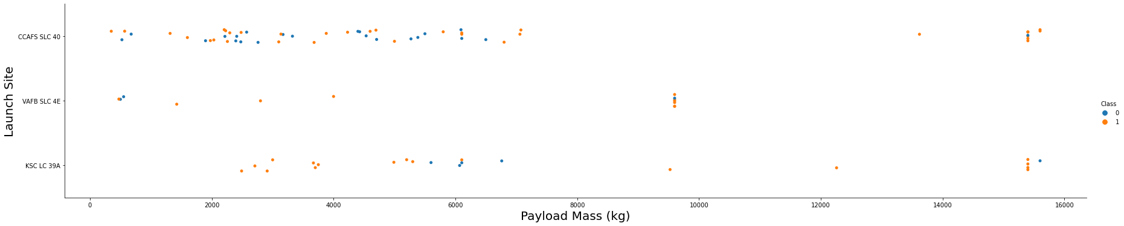
Payload vs. Launch Site
Explanation:
- For every launch site the higher the payload mass, the higher the success rate.
- Most of the launches with payload mass over 7000 kg were successfull.
- KSC LC 39A has a 100% success rate for payload mass under 5500 kg too.

Slide 22
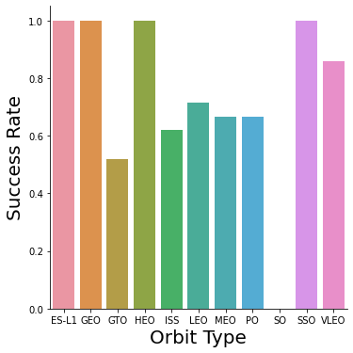
Success Rate vs. Orbit Type
Explanation:
- Orbits with 100% success rate are:
ES-L1
GEO
HEO
SSO
- Orbits with 0% success rate are:
SO
- Orbits with success rate between 50% and 85%:
GTO
ISS
LEO
MEO
PO

Slide 23
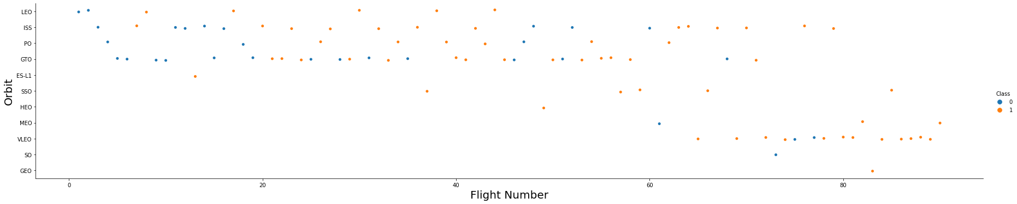
Flight Number vs. Orbit Type
Explanation:
In the LEO orbit the Success appears related to the number of flights; on the other hand, there seems to be no relationship between flight number when in GTO orbit.

Slide 24
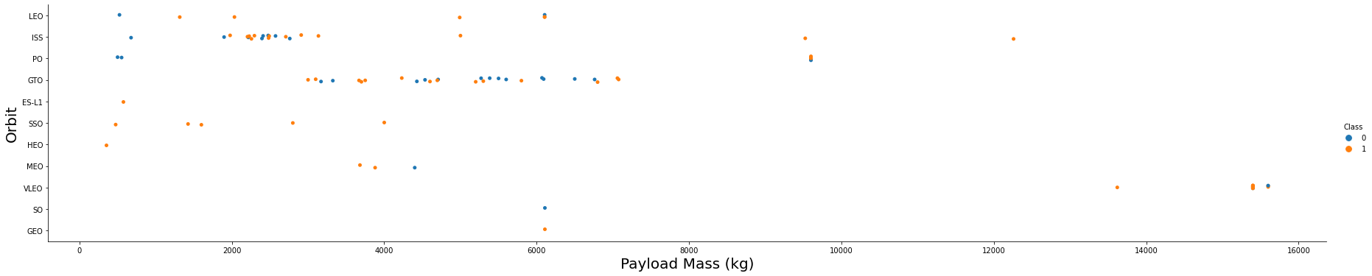
Payload vs. Orbit Type
Explanation:
Heavy payloads have a negative influence on GTO orbits and positive on GTO and Polar LEO (ISS) orbits.

Slide 25
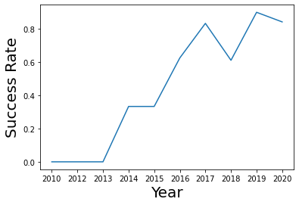
Launch Success Yearly Trend
Explanation:
It can be observed that the success rate kept increasing from 2013 to 2020. There was a small drop in the success rate during 2017-2018

Slide 26
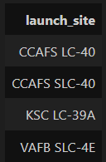
All Launch Site Names
SELECT DISTINCT launch_site FROM SPACEXDATASET
Explanation:
Displays the names of the unique launch sites in the space mission.

Slide 27
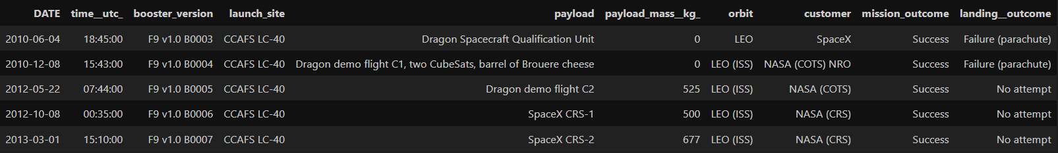
Launch Site Names Begin with 'CCA'
SELECT * FROM SPACEXDATASET WHERE launch_site LIKE 'CCA%' LIMIT 5;
Explanation:
Display 5 records where launch sites begin with the string 'CCA'.

Slide 28
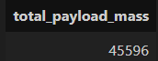
Total Payload Mass
SELECT SUM(payload_mass__kg_) AS total_payload_mass FROM SPACEXDATASET WHERE customer = 'NASA (CRS)';
Explanation:
Displays the total payload mass carried by boosters launched by NASA (CRS).

Slide 29
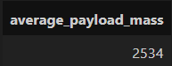
Average Payload Mass by F9 v1.1
SELECT AVG(payload_mass__kg_) AS average_payload_mass FROM SPACEXDATASET WHERE booster_version LIKE '%F9 v1.1%';
Explanation:
Displays average payload mass carried by booster version F9 v1.1.

Slide 30
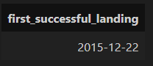
First Successful Ground Landing Date
SELECT MIN(date) AS first_successful_landing FROM SPACEXDATASET WHERE landing__outcome = 'Success (ground pad)';
Explanation:
Lists the date when the first successful landing outcome in ground pad was achieved.

Slide 31
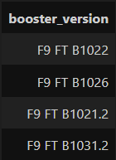
Successful Drone Ship Landing with Payload between 4000 and 6000
SELECT booster_version FROM SPACEXDATASET WHERE landing__outcome = 'Success (drone ship)' AND payload_mass__kg_ BETWEEN 4000 AND 6000;
Explanation:
List the names of the boosters which have success in drone ship and have payload mass greater than 4000 but less than 6000.

Slide 32
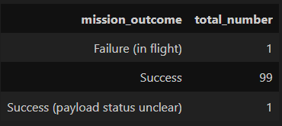
Total Number of Successful and Failure Mission Outcomes
SELECT mission_outcome, COUNT(*) AS total_number FROM SPACEXDATASET GROUP BY mission_outcome;
Explanation:
Lists the total number of successful and failure mission outcomes.

Slide 33
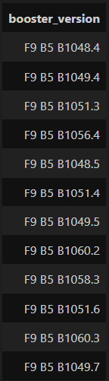
Boosters Carried Maximum Payload
SELECT booster_version FROM SPACEXDATASET WHERE payload_mass__kg_ = (SELECT MAX(payload_mass__kg_) FROM SPACEXDATASET);
Explanation:
Lists the names of the booster_versions which have carried the maximum payload mass. Use a subquery.

Slide 34
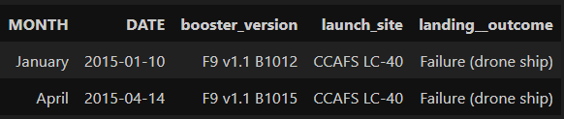
2015 Launch Records
SELECT monthname(date) AS month, date, booster_version, launch_site, landing__outcome FROM SPACEXDATASET
WHERE landing__outcome = 'Failure (drone ship)' AND year(date) = 2015;
Explanation:
Lists the failed landing outcomes in drone ship, their booster versions, and launch site names for the year 2015.

Slide 35
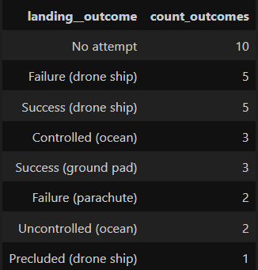
Rank Landing Outcomes Between 2010-06-04 and 2017-03-20
SELECT landing__outcome, COUNT(*) AS count_outcomes FROM SPACEXDATASET
WHERE date BETWEEN '2010-06-04' AND '2017-03-20'
GROUP BY landing__outcome
ORDER BY count_outcomes DESC;
Explanation:
Rank the count of landing outcomes (such as Failure (drone ship) or Success (ground pad)) between the date 2010-06-04 and 2017-03-20, in descending order.

Slide 36

Section 3

Slide 37
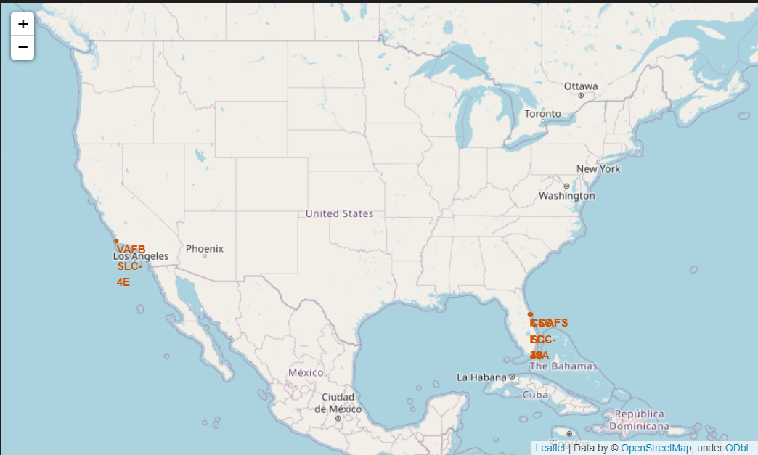
Complete Launch Site Markers
Description: This map includes markers for all SpaceX launch sites using their latitude and longitude coordinates.
Purpose: To visualize the locations of all SpaceX launch sites on a map.

Slide 38
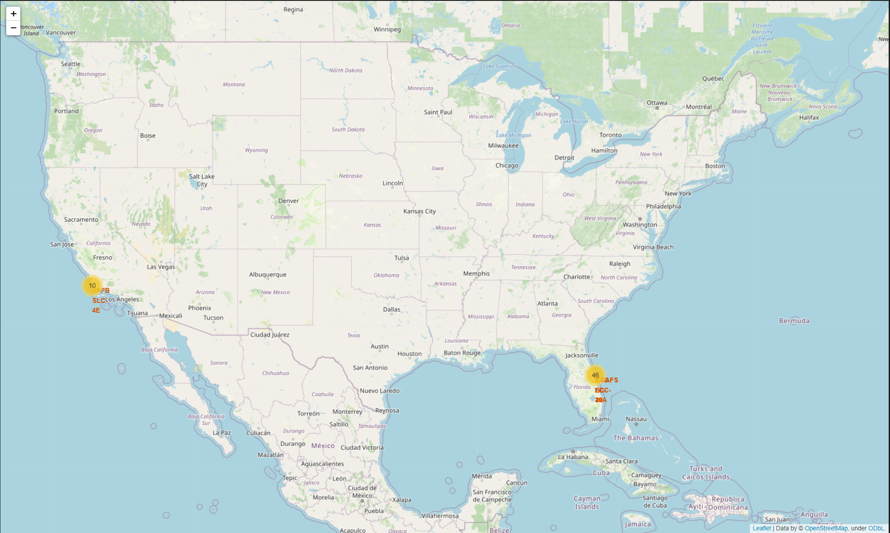
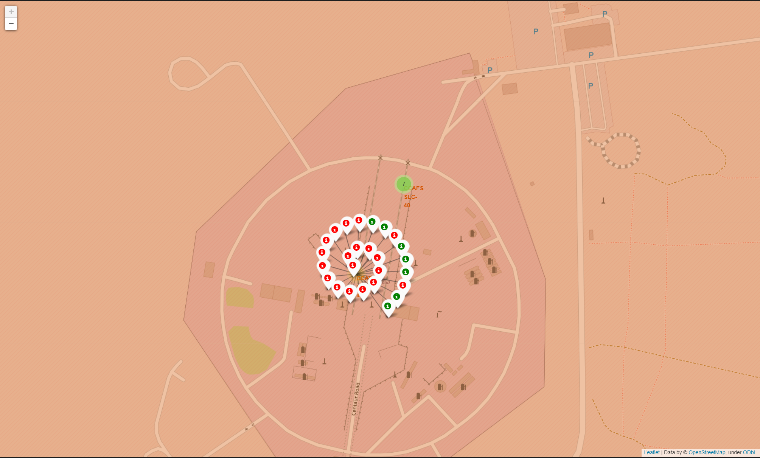
Launch Outcome Markers
Description: This map enhances the previous map by adding markers for each launch outcome. Green markers indicate successful launches, and red markers indicate failed launches.
Purpose: To visualize the success and failure rates of launches at each site.

Slide 39
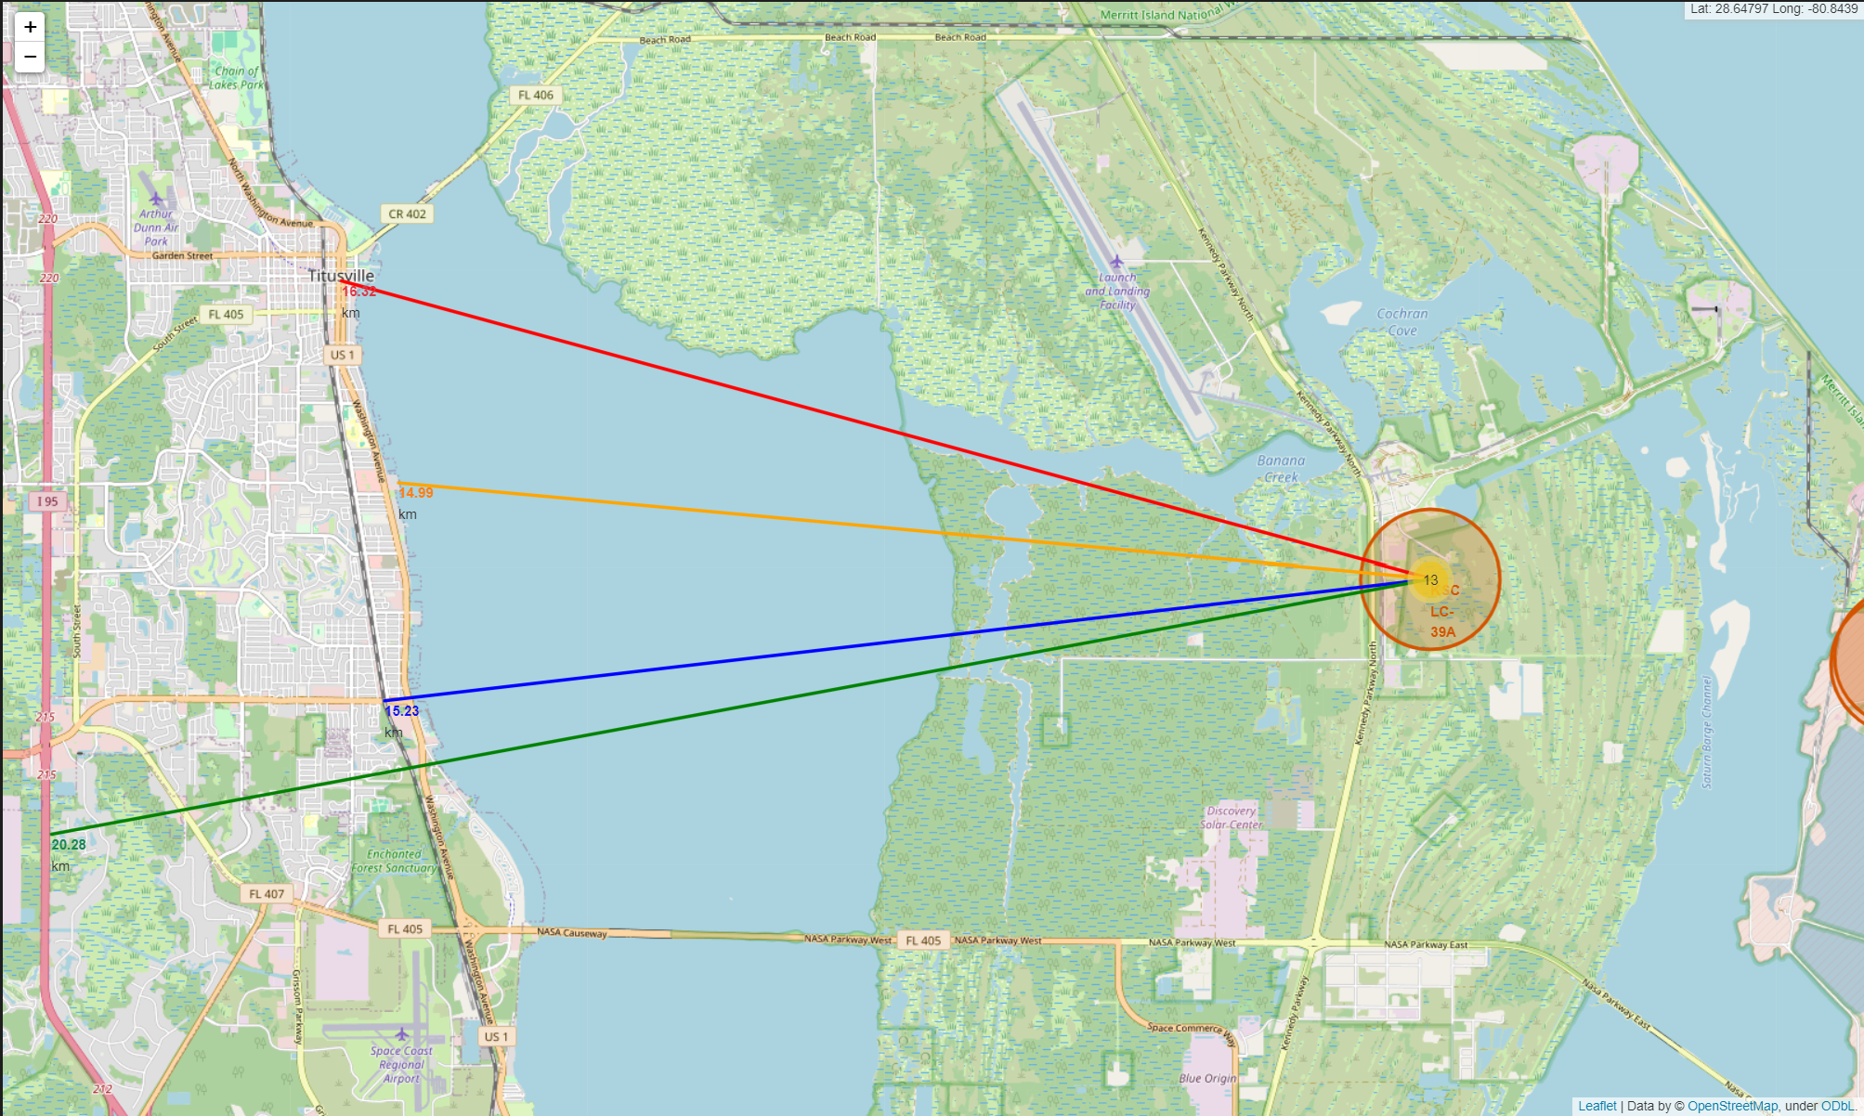
Distance to Nearest Features
Description: This map includes markers and lines showing the distances from a launch site to the nearest city, coastline, and highway.
Purpose: To calculate and visualize the proximity of launch sites to cities, coastlines, and highways.

Slide 40

Section 4

Slide 41
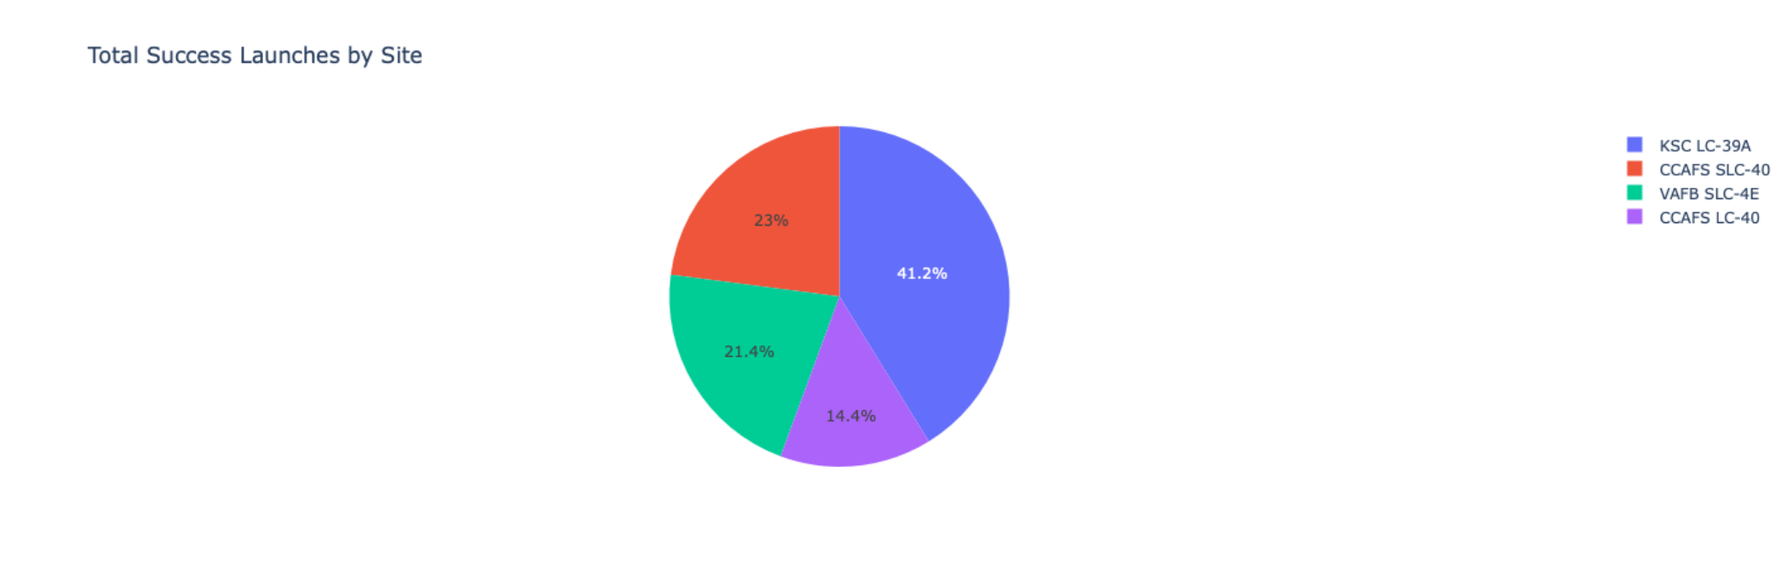
Launch Success Rate of All Sites
Explanation:
The chart clearly shows that from all the sites, KSC LC-39A has the most successful launches.

Slide 42
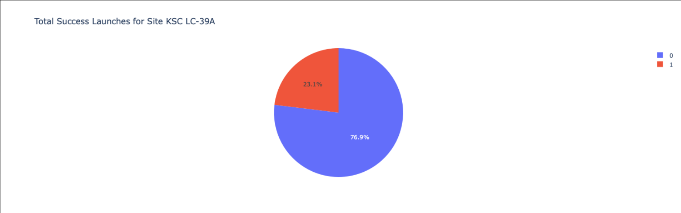
Launch Site with Highest Launch Success Rate
Explanation:
KSC LC-39A has the highest launch success rate (76.9%) with 10 successful and only 3 failed landings.

Slide 43
<Dashboard Screenshot 3>
Replace <Dashboard screenshot 3> title with an appropriate title
Show screenshots of Payload vs. Launch Outcome scatter plot for all sites, with different payload selected in the range slider
Explain the important elements and findings on the screenshot, such as which payload range or booster version have the largest success rate, etc.

Slide 44

Section 5

Slide 45
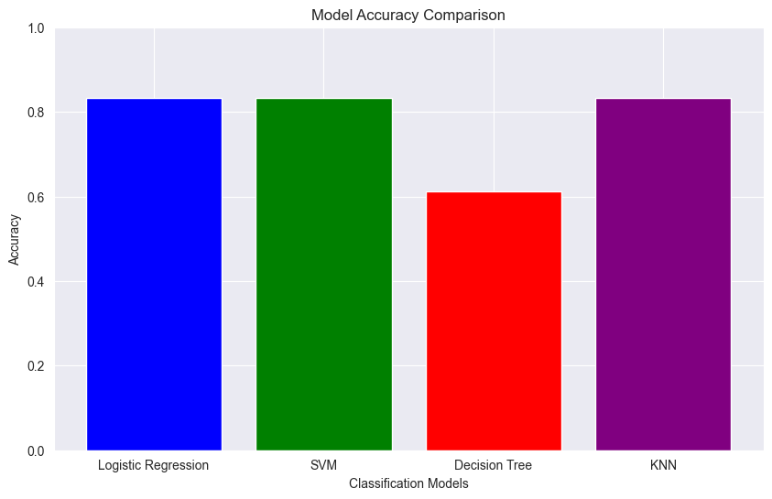
Classification Accuracy
The model with the highest accuracy is Logistic Regression with an accuracy of 0.83

Slide 46
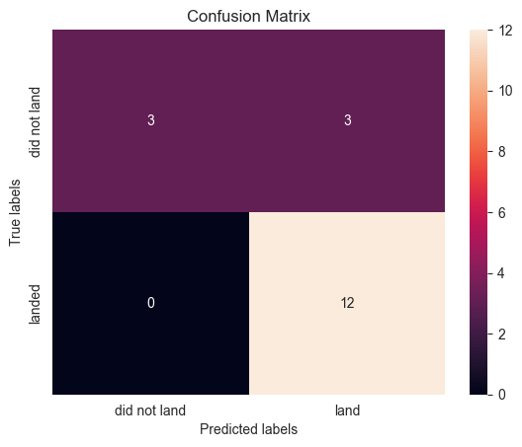
Confusion Matrix
True Labels: The actual labels from the test dataset.
Predicted Labels: The labels predicted by the Decision Tree model.
Confusion Matrix: A table used to describe the performance of a classification model. It shows the number of correct and incorrect predictions made by the model compared to the actual outcomes (true labels).

Slide 47
Conclusions
Logistic Regression Model is the best algorithm for this dataset.
Launches with a low payload mass show better results than launches with a larger payload mass.
Most of launch sites are in proximity to the Equator line and all the sites are in very close proximity to the coast.
The success rate of launches increases over the years.
KSC LC-39A has the highest success rate of the launches from all the sites.
Orbits ES-L1, GEO, HEO and SSO have 100% success rate.

Slide 48


